Slide 1
HEATSTROKE DETECTION
CAP
SANIL RODRIGUES-8489

Slide 2
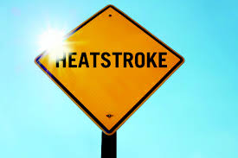
HEATSTROKE
Heatstroke is a condition caused by your body overheating, usually as a result of prolonged exposure to or physicaly in high temperatures.

Slide 3
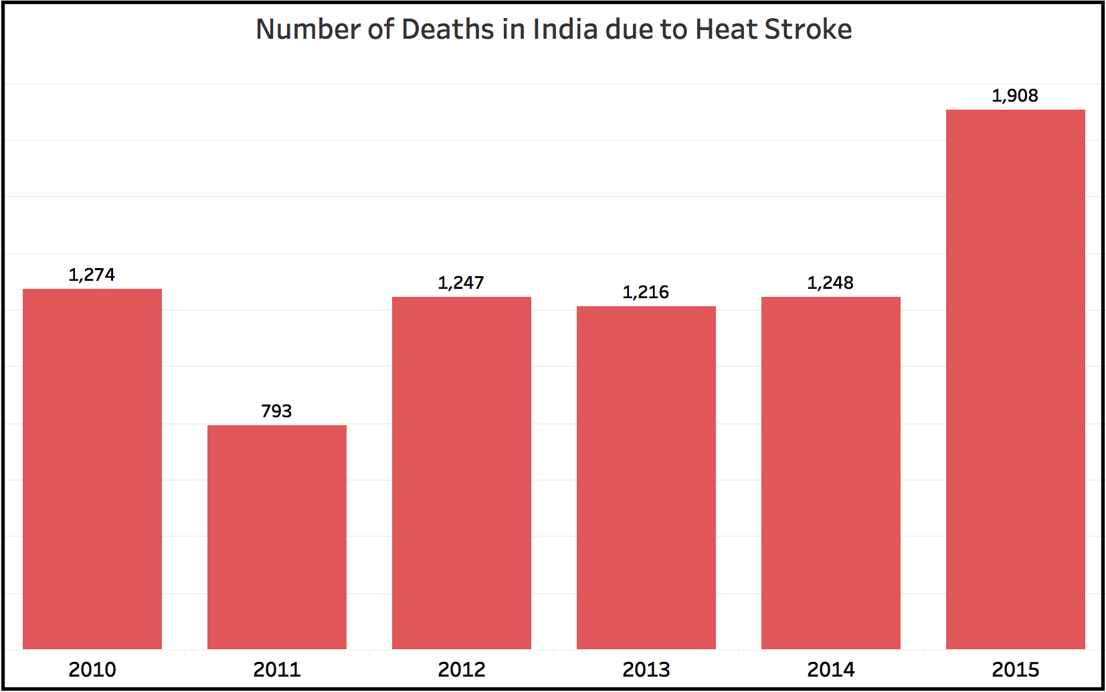
STATISTICS
Out of every 5 unnatural deaths in india 1 is caused due to heatstroke in india in summers.

Slide 4
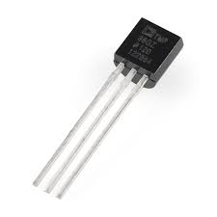
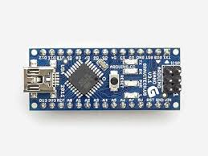
WHAT DO WE NEED?
Arduino Nano.
2. Temperature Sensor.
3. Buzzer
4. Wifi module

Slide 5
WORKING
The entire setup will be mounted on a cap.
Temperature sensor will sense the data and accordingly the buzzer will make an alert.
The data which is sensed will be uploaded to cloud.

Slide 6
PURPOSE
This is something made watching current condition of Indian summers.
We can use this technology to reduce the amount of deaths caused due to heat stroke .
Heat Stroke cannot be stopped completely but can be prevented by using such devices.

Slide 7
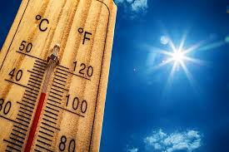
CONCLUSION
For people who live in subtropical or tropical regions, running in hot temperatures is unavoidable.
Our idea is to help the society by this small contribution for fighting against heatstroke.

Slide 8
THANK YOU…!!!

